Slide 1
Functional Programming
Team Java

Slide 2
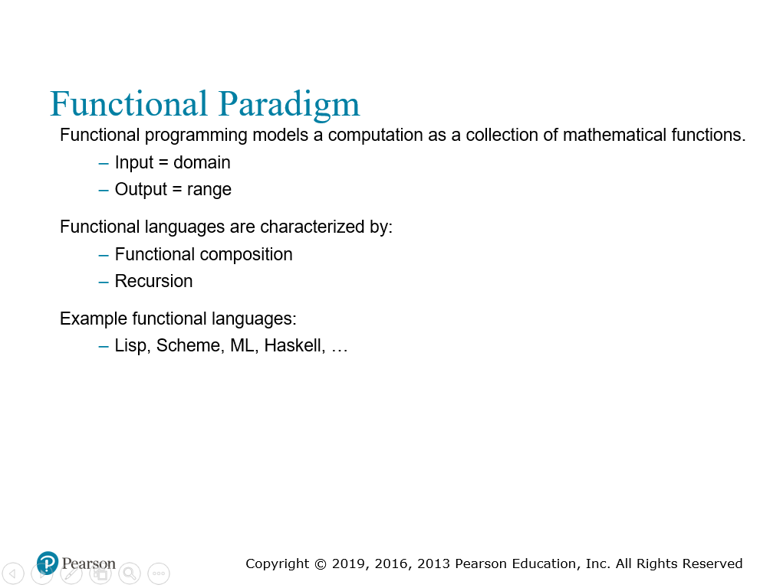
Question: What’s one of biggest uses of Python?
Data analysis
Team Java
(Java in Action Ch 1.1 – Ch 1.2)
Notes:
Sebesta Chapter 2

Slide 3
“Big Data”
Question: What is a useful feature for Big Data processing?
Parallel Programming
Team Java
(Java in Action Ch 1.1 – Ch 1.2)

Slide 4
Java 8 and Newer:
Introduction of New Concepts:
Stream Processing
“Stream” – A sequence of data items that are produced one at a time
Concept can help with implementing parallelism for free*
*Question: If you recall of Operating Systems, what are problems that may arise when doing parallelism?
Team Java
(Java in Action Ch 1.2)

Slide 5
Java 8 and Newer:
Introduction of New Concepts:
- Behavior Parametrization
Ability to pass code to an API
No data mutation & Behavior Parametrization are the cornerstone of functional programming
Team Java
(Java in Action Ch 1.2)

Slide 6
Java 8 and Newer:
New features:
Streams API – March 20th with Simone
Supports Parallel Processing of “Big Data”
Makes use of the idea of behavior as a parameter
Rule: No data mutation
Lambdas – Today’s Topic
Introduced with Streams
Other Concurrency Improvements – April 3rd with Chris
Team Java
(Java in Action Ch 1.1 – Ch 1.2; Part 2; Part 5 )

Slide 7
Question: What features in Java makes it useful for programmers?
A robust standard library
Team Java
(Java in Action Ch 1.2)

Slide 8
A robust standard library
We don’t need to know how the libraries are implemented
Written by better programmers who can write more efficient code
We can focus on what we want to do with those libraries
Examples:
Collections and ArrayLists; Stacks; LinkedLists;
Team Java
(Java in Action Ch 1.2)

Slide 9
“what” > “how”
Team Java
(Java in Action Ch 1.2)

Slide 10
Not only Java:
Question: What was the first functional programming language? (from Week 2 - Sebesta Chapter 2)
LISP
JavaScript
Scala – April 10th with Zia
Team Java
(Java in Action Ch 1.6; Part 6)

Slide 11


Project A: Launch the BlueJ project.
Apple Class
Properties of Apple private double weight; // weight of the Apple
private String color; // color of the Apple
private int numberSeeds; // number of seeds in Apple
private boolean isPoisonous; // whether or not Apple is poisonous
Methods of Apple
getWeight(), setWeight(Double weight), String getColor(), setColor(String color), ... Rest of the getters and setters
AppleReader Class
It takes in data from a .csv to help create a ArrayList of Apples
Team Java
(Java in Action Ch 2)

Slide 12

Project A: Launch the BlueJ project. (cont.)
FilteringApples
Has starter code which goal is to filter a list of Apples.
private ArrayList<Apple> apples; // The list of Apples to filter, stores all the apples
/**
* Create an AppleFilter.
*/
public FilteringApples() {
AppleReader reader = new AppleReader();
this.apples = reader.getApples("appleList.csv"); // reads in data from CSV
} // Uses the AppleReader class to get the list of Apples
Team Java
(Java in Action Ch 2)

Slide 13
Exercise 1: Write a program to filter out Apples that are Green.
See the starter code below.
Store the Apples you filtered out in result
public List<Apple> filterGreenApples(){
List<Apple> result = new ArrayList<>();
/** Your code here **/
printList(result);
return result;
}
What if you now want to filter out Apples that are Red? Or even Yellow?
(Java in Action Ch 2.1)

Slide 14
Exercise 2: Now write a program to filter out Apples that are of the type of color specified by a parameter.
Take in a String color as a parameter.
What if we wanted to filter by the Apple’s weight?
(Java in Action Ch 2.1)

Slide 15
Exercise 3: Now write a program to filter out Apples that are of the type of color specified by a parameter.
Take in a int weight as a parameter
What if we wanted to filter by the Apple’s weight and color or something else?
(Java in Action Ch 2.1)
Notes:
We would keep on repeating code – where there is a chance for error.

Slide 16
Example 4: We can try behavior parameterization.
Let’s try it with Exercise 1.
First create a new Interface: ApplePredicate, with the following code.
public interface ApplePredicate {
public boolean test(Apple a);
}
Question: What are interfaces for?
Team Java
(Java in Action Ch 2.2)

Slide 17
Example 4: We can try behavior parameterization. (cont.)
Create a new class: AppleColorPredicate, with the following code.
public class AppleColorPredicate implements ApplePredicate {
public boolean test(Apple apple){
return "Green".equals(apple.getColor());
}
}
Team Java
(Java in Action Ch 2.2)

Slide 18
Example 4: We can try behavior parameterization. (cont.)
Now add this method to: FilteringApples, with the following code.
public List<Apple> filter(ApplePredicate p) {
List<Apple> result = new ArrayList<>();
for (Apple apple : apples) {
if (p.test(apple)) {
result.add(apple);
}
}
printList(result);
return result;
}
(Java in Action Ch 2.2)

Slide 19
And Now…
Lambdas
Team Java
(Java in Action Ch 2.3; Ch 3.1 - 3.2)

Slide 20
More concise behavior parametrization
Team Java
(Java in Action Ch 2.3; Ch 3.1 - 3.2)

Slide 21
Expression-style:
(parameters) -> expression;
Block-style:
(parameters) -> { statements; }
List of parameters
arrow
body
Team Java
(Java in Action Ch 2.3; Ch 3.1 - 3.2)

Slide 22
Anonymous—it doesn’t have an explicit name like a method would normally have; less to write and think about!
Function—a lambda isn’t associated with a particular class like a method is. But like a method, a lambda has a list of parameters, a body, a return type, and a possible list of exceptions that can be thrown.
Passed around—A lambda expression can be passed as argument to a method or stored in a variable.
Concise—You don’t need to write a lot of boilerplate like you do for anonymous classes.
Team Java
(Java in Action Ch 2.3; Ch 3.1 - 3.2)

Slide 23
Where can you use lambdas?
Within Functional Interfaces
Functional Interfaces that specifies only one abstract method. Example:
Lambdas are responsible for implementing that interface, directly inline.
No need to create a separate class.
public interface ApplePredicate {
public boolean test(Apple a);
}
(Java in Action Ch 2.3; Ch 3.1 - 3.2)

Slide 24
Example 5: We can try using lambdas now.
Let’s try it with Exercise 1.
How do we write the lambda for it?
public interface ApplePredicate {
public boolean test(Apple a);
}
(parameters) -> expression
(Apple apple) -> expression
(Apple apple) -> apple.getColor().equals("Green")
Team Java
(Java in Action Ch 2.3; Ch 3.1 - 3.2)

Slide 25
Example 6: We can try using lambdas now.
Let’s try it with Yellow.
public interface ApplePredicate {
public boolean test(Apple a);
}
(parameters) -> expression
(Apple apple) -> expression
(Apple apple) -> apple.getColor().equals(“Yellow")
Team Java
(Java in Action Ch 2.3; Ch 3.1 - 3.2)

Slide 26
Exercise 7: We can try using lambdas now.
Let’s try it with weight > 100.
public interface ApplePredicate {
public boolean test(Apple a);
}
(parameters) -> expression
(Apple apple) -> expression
(Apple apple) -> apple.getWeight() > 100;
Team Java
(Java in Action Ch 2.3; Ch 3.1 - 3.2)

Slide 27
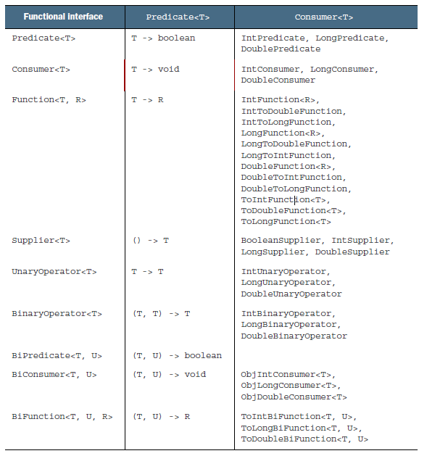
Functional Interfaces (again)
Java has already provided a bunch of Functional Interfaces
Team Java
(Java in Action Ch 3.4)
Notes:
Import java.util.function.Predicate

Slide 28
Example 8: We can try use the built in Functional Interface
import java.util.function.Predicate;
Team Java
(Java in Action Ch 3.4)

Slide 29
Lambdas aren’t just limited to this simple example
(Apple a1, Apple a2) -> a1.getWeight().compareTo(a2.getWeight())
(with the Comparable<T> interface)
(Apple a) -> System.out.println(a.getWeight())
(with the Consumer<T> interface)
Team Java
(Java in Action Ch 3.4)

Slide 30
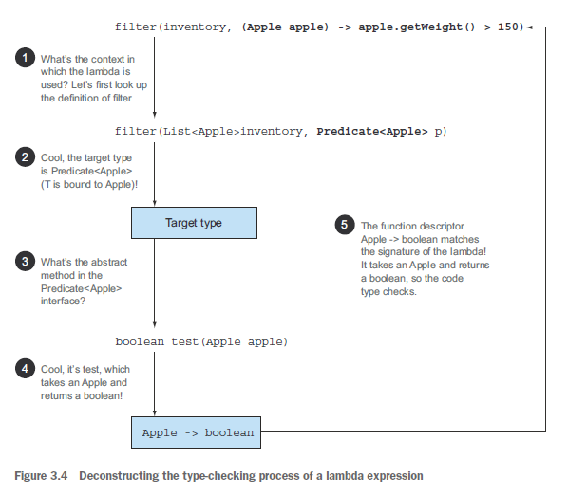
Lambdas and type checking
(Apple apple) -> apple.getWeight() > 100;
(apple) -> apple.getWeight() > 100;
Team Java
(Java in Action Ch 3.5)

Slide 31
A summary:
apples.stream().filter((apple) -> apple.getWeight() > 100);
Team Java
(Java in Action Part 1)

Slide 32
A summary:
apples.stream().filter((apple) -> apple.getWeight() > 100);
Team Java
(Java in Action Part 1)

Slide 33
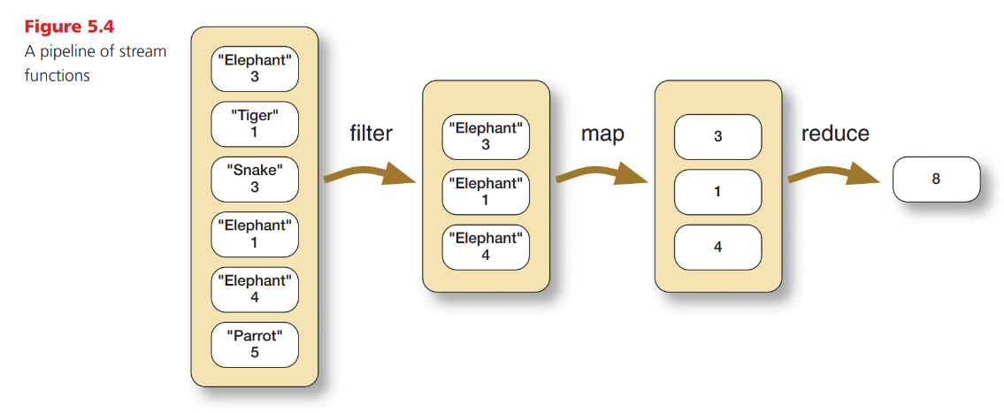
Team Java
(Java in Action Part 2)

